Slide 1

Photosynthetic Adaptations of Polar Phytoplankton to Extreme Low Light
Natasha Madeleine Ryan
Supervised By Dr. Douglas A. Campbell

Slide 2
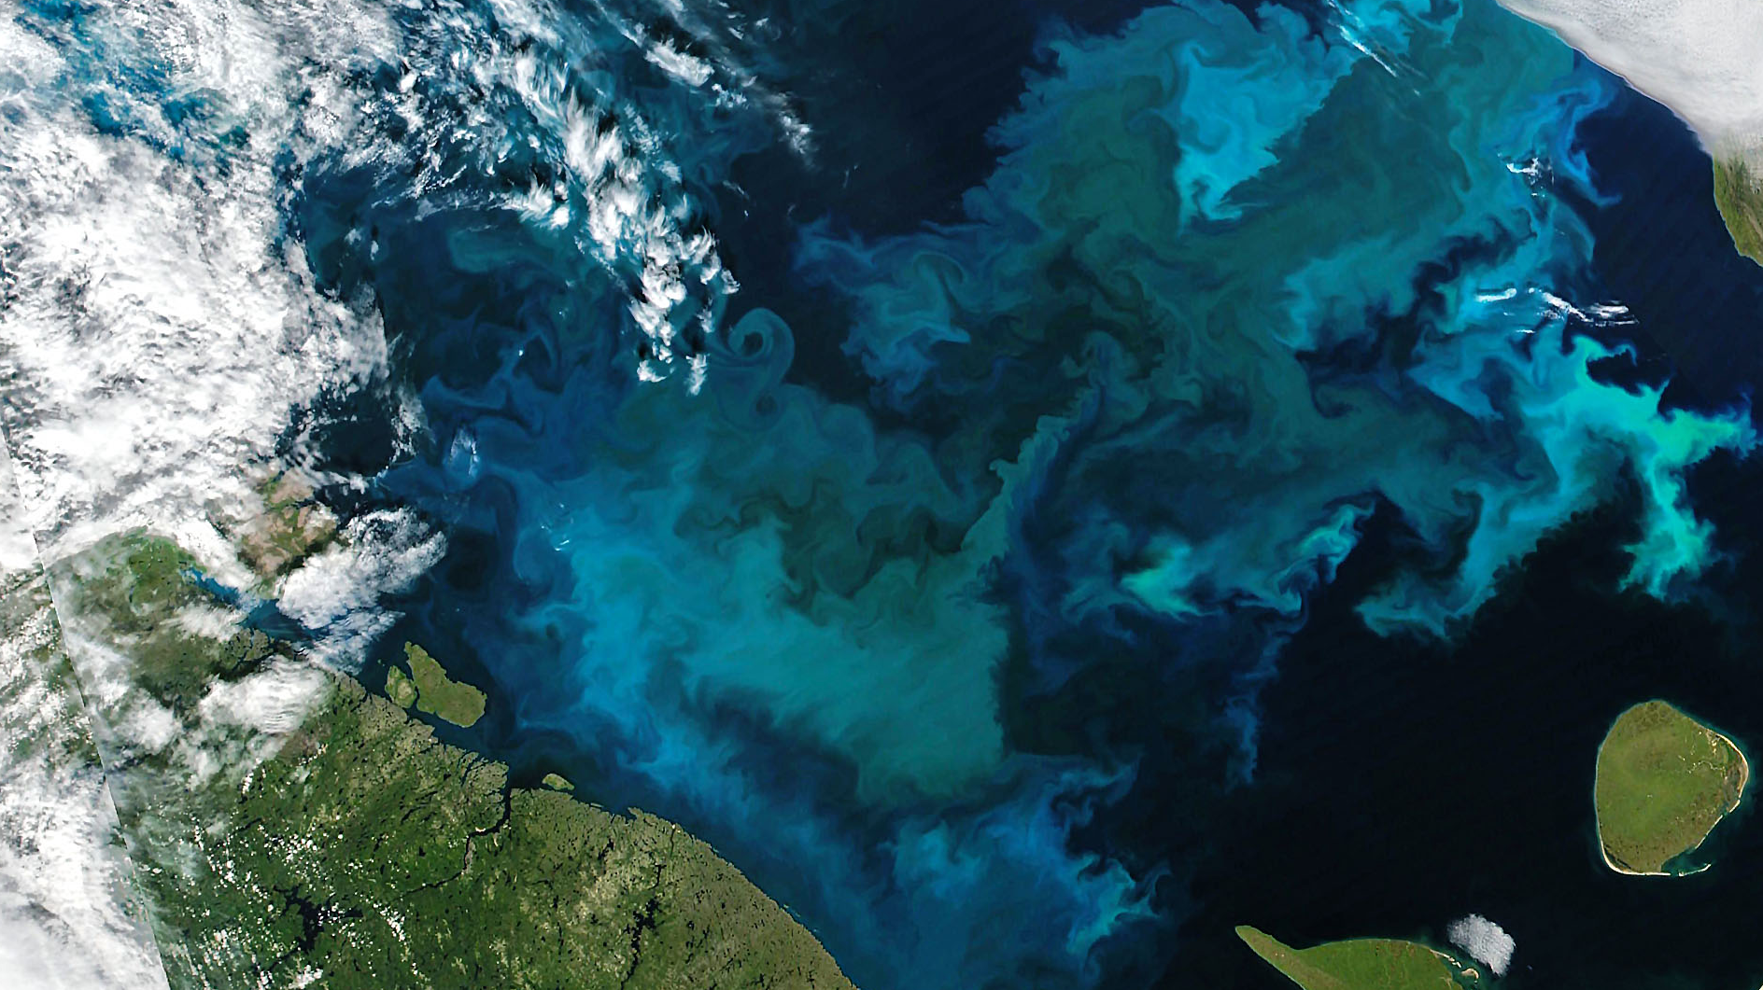
Ardyna & Arrigo, 2020. Nature Climate Change Image: Phytoplankton Bloom in the Barents Sea, August 2021, Joshua Stevens (NASA)

Slide 3
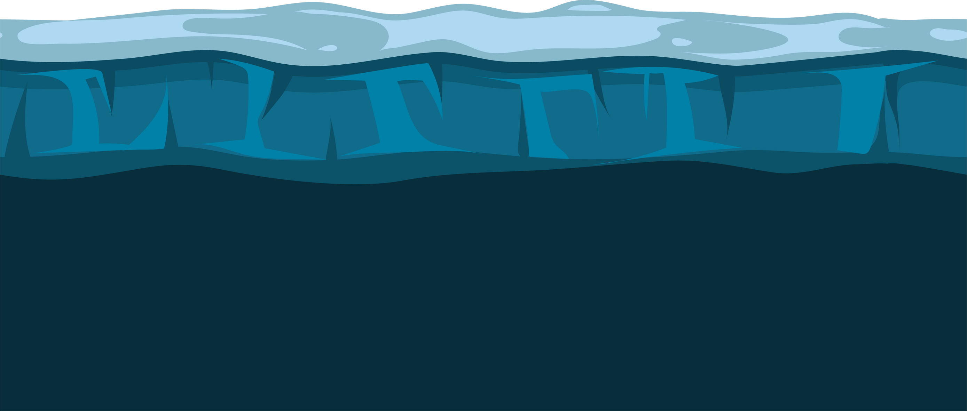
Photic Constraints
Light Attenuation
Solar Angle
Randelhoff et al., 2020. Science Advances Hancke et al., 2018. Journal of Geophysical Research: Oceans

Slide 4
Have polar phytoplankton adapted to extremely low light by increasing their efficiency of photosynthetic energy conversion?

Slide 5
Have polar phytoplankton adapted to extremely low light by increasing their efficiency of photosynthetic energy conversion?
hypothesized mechanism: suppressing energetically wasteful charge recombinations in Photosystem II

Slide 6
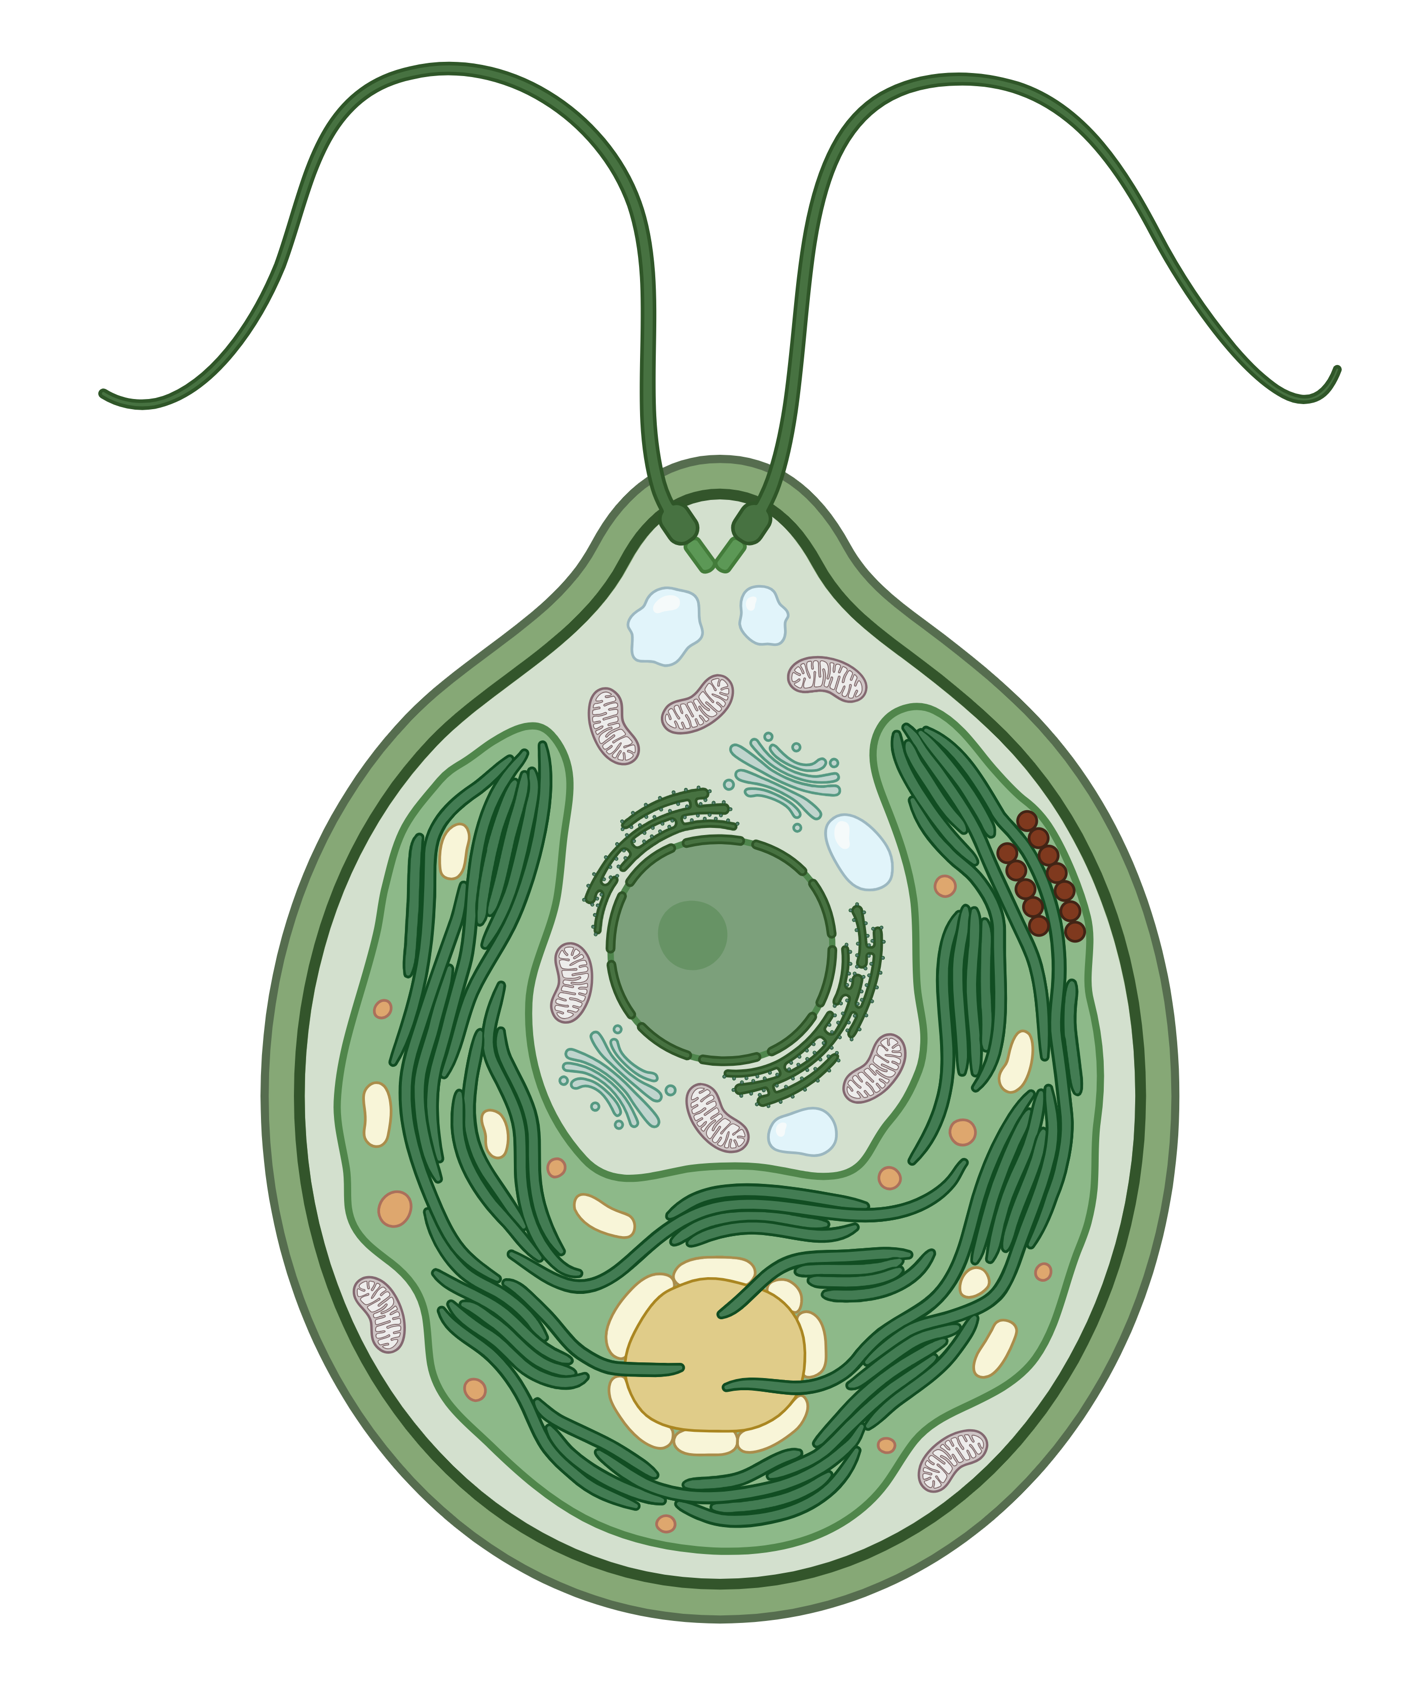
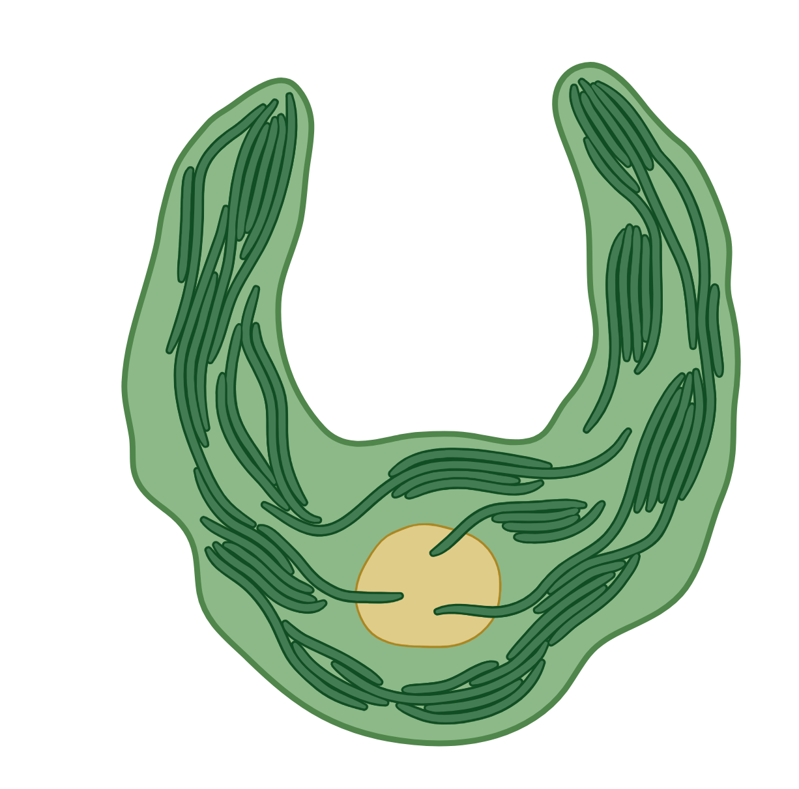
Phytoplankton Cell
Kirk, 2011. Cambridge University Press Image: BioRender

Slide 7

Chloroplast
Kirk, 2011. Cambridge University Press

Slide 8
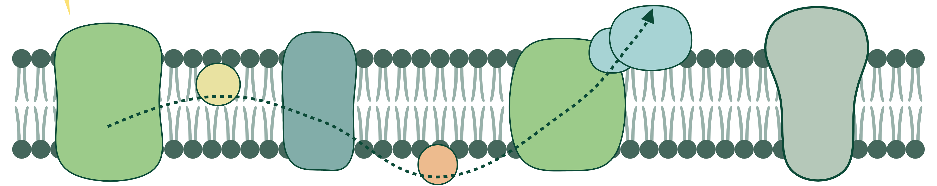
NADP⁺
NADPH
ATP
Synthase
PSII
Cyt b₆f
PSI
PQ
PC
Thylakoid Membrane
Kirk, 2011. Cambridge University Press

Slide 9
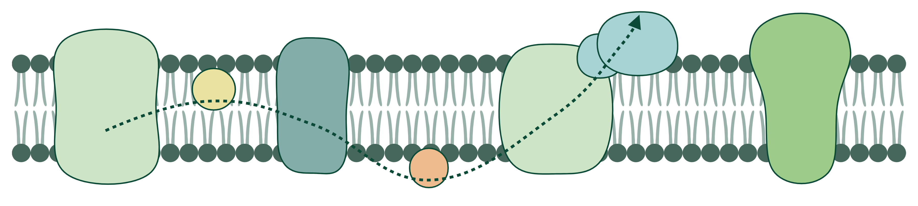
NADP⁺
NADPH
ATP
Synthase
PSII
Cyt b₆f
PSI
PQ
PC
Thylakoid Membrane
Kirk, 2011. Cambridge University Press

Slide 10

Reaction Center II
Electron Transport
Oxygen-evolving complex
Mn₄CaO₅
Reaction Center II
Photosystem II
Kirk, 2011. Cambridge University Press

Slide 11

Reaction Center II
Electron Transport
Oxygen-evolving complex
Reaction Center II
Mn₄CaO₅
e⁻
Photosystem II
Kirk, 2011. Cambridge University Press

Slide 12
Reaction Center II
Electron Transport
e⁻
e⁻
e⁻
Oxygen-evolving complex
Reaction Center II
Mn₄CaO₅
e⁻
Photosystem II
Kirk, 2011. Cambridge University Press

Slide 13
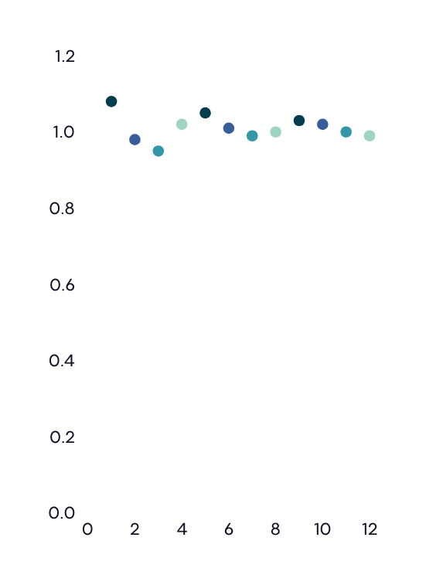





StChlF Approach
e⁻
e⁻
Mn₄CaO₅
Chlorophyll Fluorescence
Oxygen-evolving complex
e⁻
1
4
2
3
Flash Number

Slide 14
Wavelet Transformation
Sample Plots: Fragilariopsis cylindrus at 0°C and 1-second flash intervals
Raw Fluorescence Data
Fourier Wavelets

Slide 15
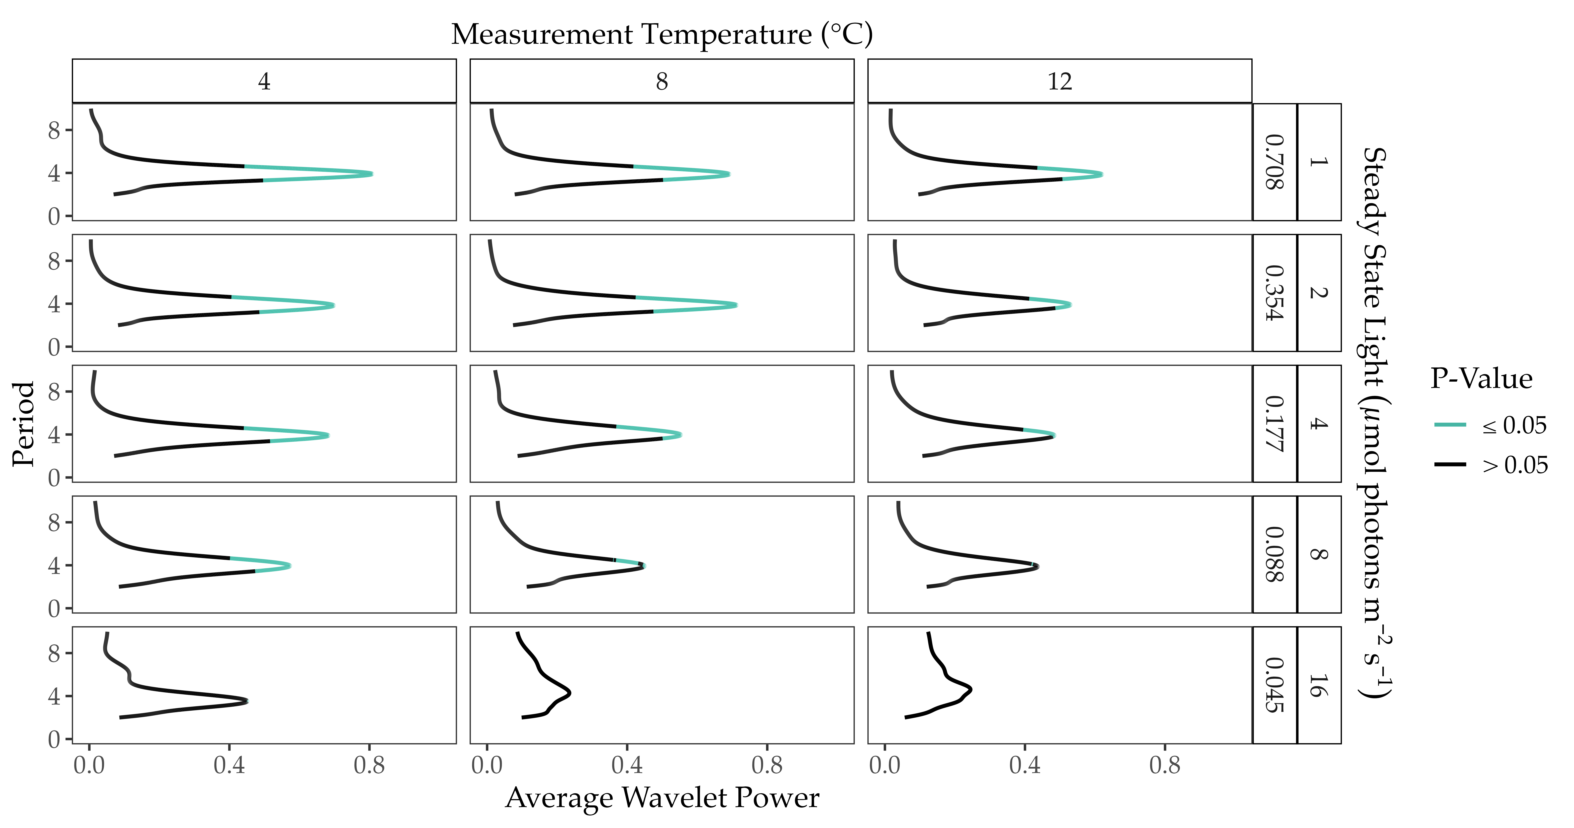
ChlF Periodicity
Sample Plot: Chlamydomonas priscuii

Slide 16
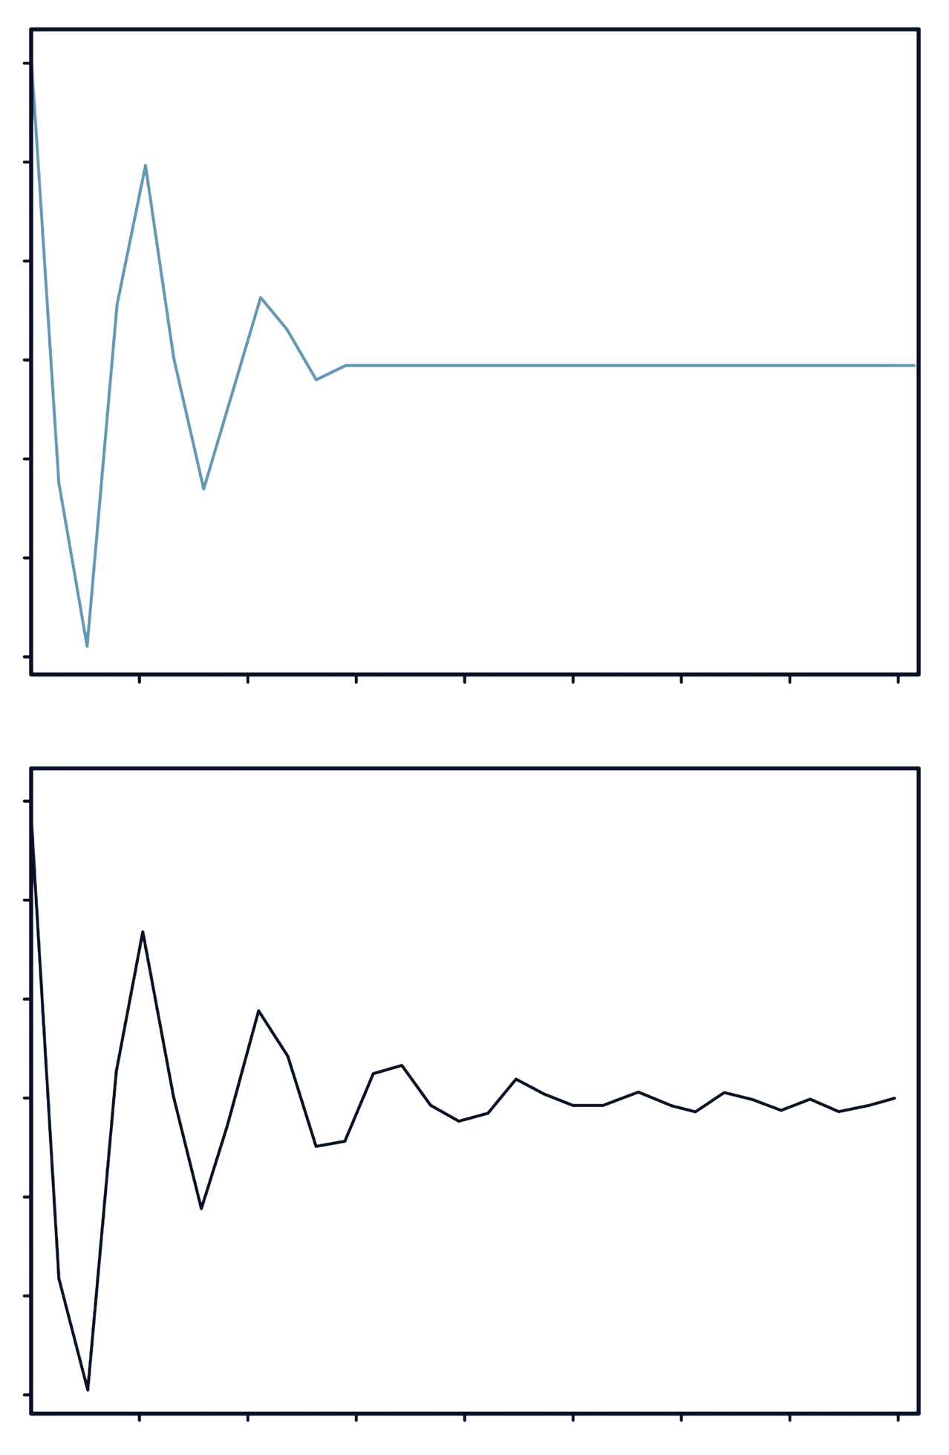
Duration of Oscillations
Original Fourier Wavelet
Reconstruction at 𝛼 =0.05
0.06
0.06
0.04
0.04
0.02
0.02
Scaled Fluorescence
0.00
0.00
-0.02
-0.02
-0.04
-0.04
-0.06
-0.06
4
8
12
16
20
24
28
32
4
8
12
16
20
24
28
32
Flash Number
Flash Number

Slide 17
Trends Within Taxa
Individual strains sustain longer cycling under higher steady-state light & lower temperatures

Slide 18
Comparison Across Taxa
Polar strains sustained longer cycling under comparable conditions

Slide 19
Key Conclusions
1
Within taxa, higher light levels and colder temperatures result in stronger maintenance of s-state cycling
2
Polar taxa exhibit significant cycling across a broader range of conditions than their temperate counterparts
3
Polar taxa maintain synchronicity in S-State cycling longer than temperate taxa under comparable conditions
Diverse polar phytoplankton exhibit the capacity to sustain photosynthesis under extreme low light, at low temperatures

Slide 20
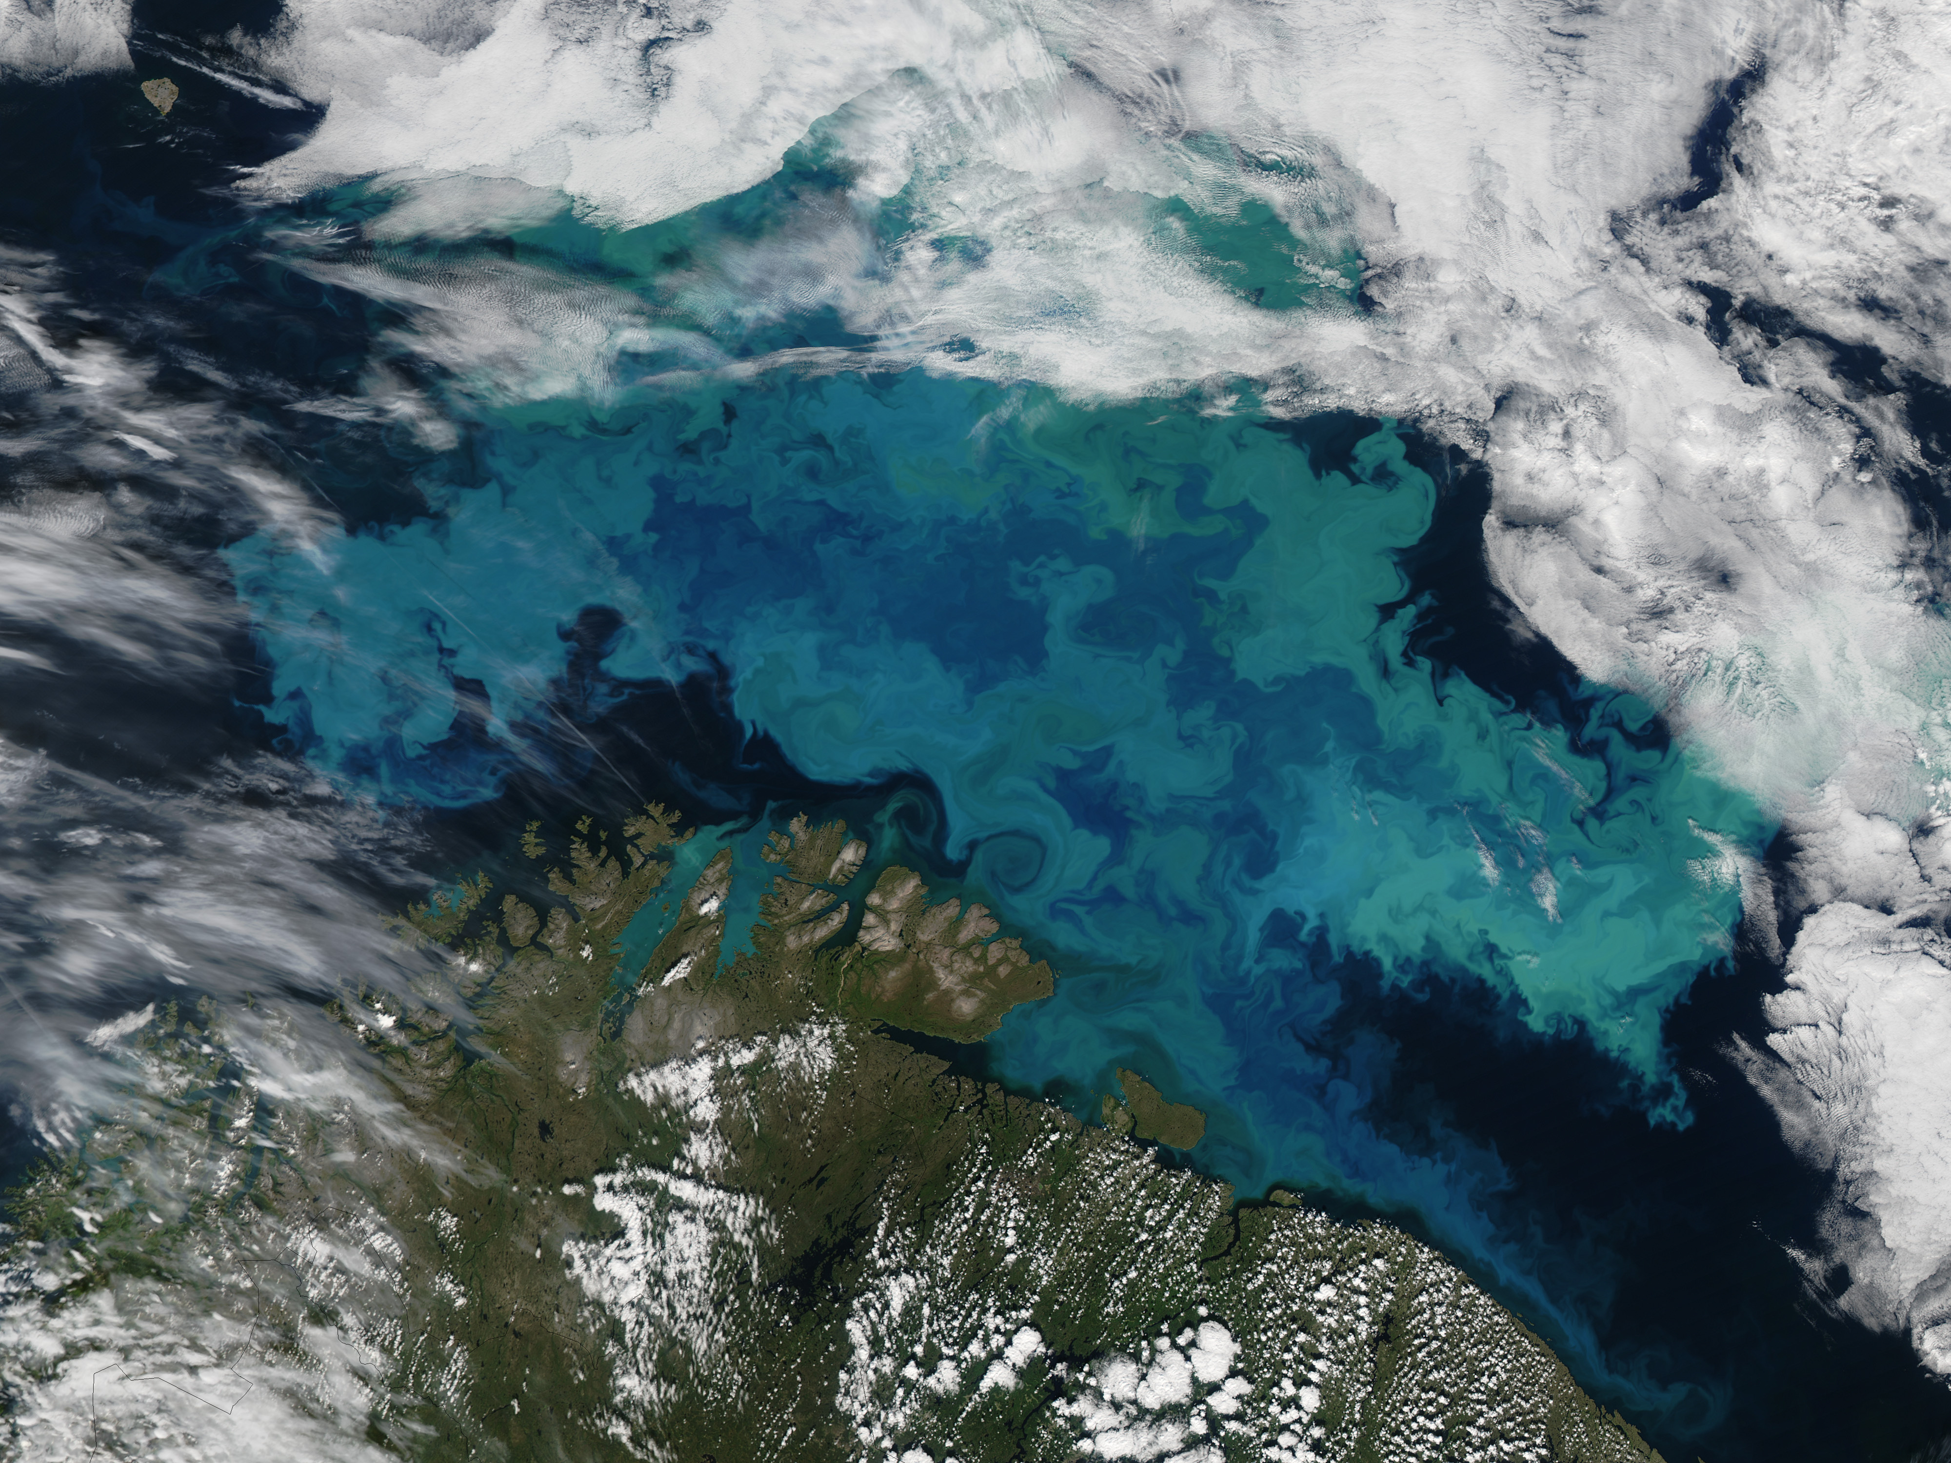





Acknowledgements
I would like to express my gratitude to my supervisor:
Dr. Douglas A Campbell
as well as Campbell Lab members:
Dr. Maximilian Berthold, Dr. Sylwia Sliwinska-Wilczewska,
Naaman Omar, & Mireille Savoie
and our partners at
The International Research Laboratory Takuvik at Université de Laval
& Cvetkovska Lab at the University of Ottawa

Slide 21
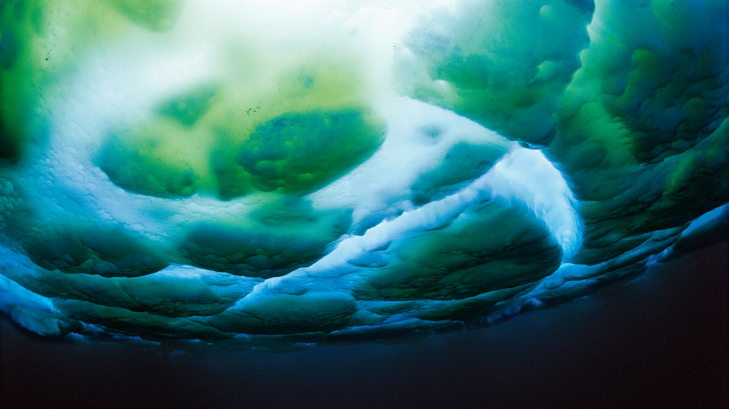
Questions?
Sub-ice algae. Image: M. Stenzel

Slide 22
References

